Slide 1
Markect basket analysis
CAPSTONE PROJECT
Presented By:
1. Student Name- santhosh M- university college of engineering kancheepuram -mechanical engineering

Slide 2
OUTLINE
Problem Statement
Proposed System/Solution
System Development Approach
Algorithm & Deployment
Result
Conclusion
Future Scope
References

Slide 3
Problem Statement
Given a transactional dataset containing records of items purchased by customers, the objective is to identify frequent item sets and association rules that reveal meaningful patterns in customer purchasing behavior. These patterns can assist retailers in making informed decisions regarding product assortment, pricing strategies, promotional activities, and overall store layout to enhance customer experience and increase sales

Slide 4
Proposed Solution
this solution framework enables retailers to uncover meaningful patterns in customer purchasing behavior and derive actionable insights to optimize various aspects of their business operations, such as product placement, marketing strategies, and overall customer satisfaction.

Slide 5
System Approach
Building the proposed solution requires combination of data processing ,feature engineering ,data visualization
System requirements:
Hardware requirements:
Processor (CPU):
A multi-core processor is recommended, especially for handling large datasets and complex computations.
Software requirement :
An os compatable with the project to run it smooth (windows ,mac ,linux)

Slide 6
System approach
Library requirement:
Data processing and analysis:
Pandas ,apyori
Data visualization:
Matplotlib , seaborn

Slide 7
Algorithm & Deployment
Data Preprocessing:
Read the transactional dataset containing records of items purchased by customers.
Generate Candidate Itemsets:
Scan the dataset to identify unique items and their counts.
Filter out infrequent items that do not meet the minimum support threshold.
Create initial candidate itemsets consisting of single items.
Results Interpretation:
Extract relevant information from the frequent itemsets and association rules, such as itemsets, support, confidence, and lift.
Organize the results into a structured format (e.g., DataFrame) for easy interpretation.
Visualization (Optional):
Visualize the frequent itemsets, association rules, or key findings using appropriate plots or graphs.
This step can help stakeholders gain insights more intuitively and effectively.
Presentation of Findings:
Communicate the discovered patterns, frequent itemsets, and association rules to relevant stakeholders.
Provide actionable insights and recommendations based on the analysis results to assist retailers in making informed decisions

Slide 8
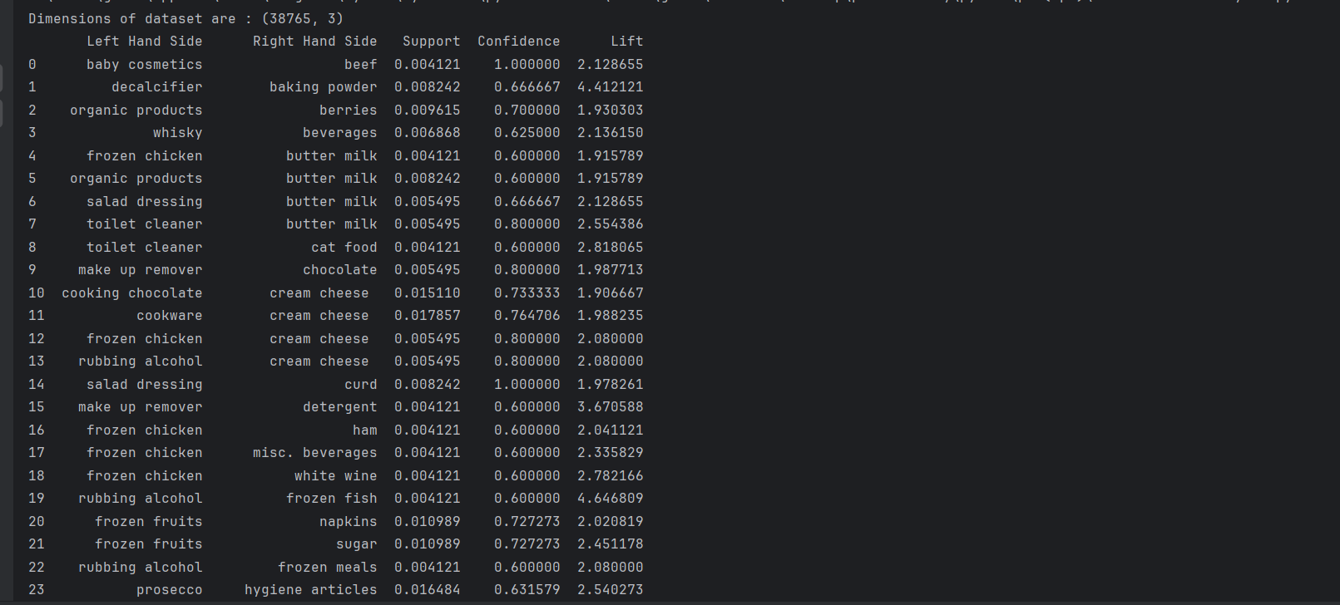
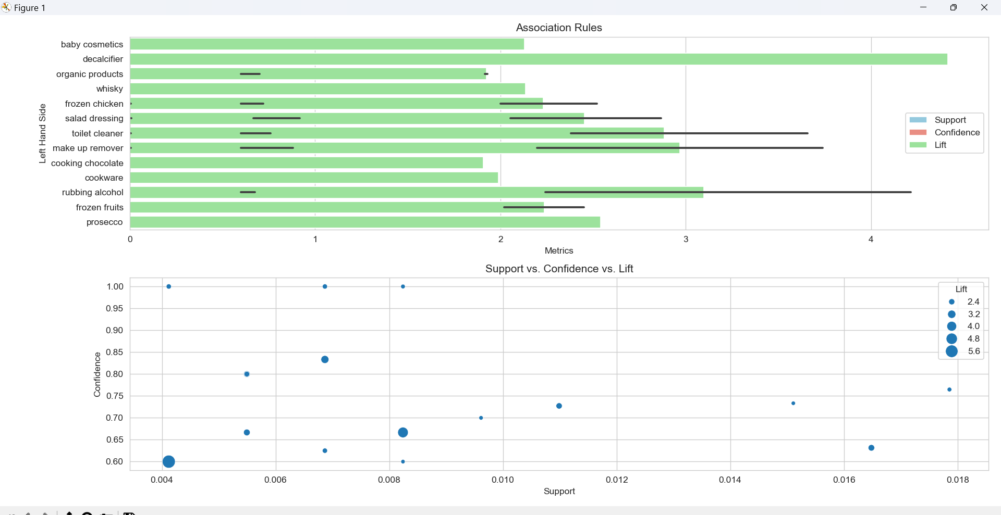
Result

Slide 9
Conclusion
Frequent Itemsets: We have identified sets of items that are frequently purchased together by customers. These frequent itemsets provide valuable insights into customer purchasing behavior and preferences.
Association Rules: By analyzing the association rules generated from frequent itemsets, we have discovered interesting patterns and relationships between different products. These rules indicate the likelihood of one item being purchased given the presence of another item in the basket.
Support, Confidence, and Lift: We have calculated support, confidence, and lift measures for each association rule. Support indicates the frequency of occurrence of a rule, confidence represents the probability of the consequent item being purchased given the antecedent item(s), and lift measures the strength of association between items.
Key Findings: Through the analysis, we have uncovered significant associations between various products. For example, we found that customers who purchase baby cosmetics are highly likely to also buy beef, indicating a potential cross-promotion opportunity.
Insights for Retailers: The insights gained from market basket analysis can help retailers improve their marketing strategies, optimize product placement, and enhance customer experience. By understanding which items are commonly purchased together, retailers can implement targeted promotions, bundle products, and optimize inventory management.

Slide 10
Future scope
Advanced Analytics Techniques: Implementing more advanced analytics techniques such as machine learning algorithms, deep learning models, or hybrid approaches to uncover complex patterns and associations in transaction data.
Real-Time Analysis: Developing real-time market basket analysis systems that can analyze transactions as they occur, enabling retailers to provide personalized recommendations and promotions in real-time.
Integration with Customer Data: Integrating market basket analysis with customer demographic and behavioral data to segment customers more effectively and tailor promotions and recommendations to individual preferences.

Slide 11
References
https://youtu.be/GsfT2sv_zCo?si=0EVj_f90LyOWyQT1
Association Rule Learning : Apriori - Market Baske (kaggle.com)

Slide 12
THANK YOU

